Slide 1


The Effects of Teacher Cultural Trainings on Student Achievement
Sirish Desai, Stephanie Landas, Noah Thro, Michelle Wu
May 2, 2024

Slide 2
Table of Contents
Introduction
Data
Exploratory Results
Methodology
Results
Conclusion

Slide 3

Introduction

Slide 4

Cultural Responsiveness Training
Research developed in the late 1990’s/early 2000’s
Training for teachers in the Albemarle County Public School (ACPS) district began in 2015-2016
All licensed full time staff to be certified by 2026
Aim to increase cultural awareness in the classroom
Notes:
Research supporting Culturally Responsive Teaching began in the late 1990’s and early 2000’s when researchers observed classroom teachers with high rates of success in accelerating the learning of students of color in schools with high numbers of students in economic hardship. Researchers described the common characteristics of these teachers: an understanding of the impact of cultural differences on student learning, high levels of rigor and a diverse set of teaching strategies matched to students’ needs, and consistent family and community engagement with students’ lives outside of the classroom.
The culturally responsive teaching certification and credentialing used by ACPS is a professional development program based on these characteristics that began in the school year of 2015-2016<https://www.cvilletomorrow.org/four-albemarle-county-public-schools-educators-amo/>. The program was created by ACPS staff in the Office of Community Engagement and in the early years (2015-2018) showed promise in impacting learning, especially among students of color and those facing economic hardship. Fully certified teachers who went through the program improved growth for students in attendance, performance on SOL assessments, family engagement, and other metrics.
As a result of this early success, the ACPS School Board included in its 2020 strategic plan an initiative to certify all VDOE licensed full-time staff in the district by 2026.

Slide 5
Research Questions
Did the cultural responsiveness training have a measurable and statistically significant impact on student growth?
Are there other variables that influence student growth more strongly?

Slide 6
Data

Slide 7
Data Overview
9,520 cases of 4th to 8th graders from the 2022-2023 academic year.
Information on:
Student demographics
Teacher demographics
Student testing outcomes from reading and math VA Standards of Learning (SOLs) exams
Expected achievement, actual achievement, and growth

Slide 8
Assumptions
Cases were unique, had no relation to each other, and has been correctly aligned
Possible for a student to have a reading row and a math row but given that we do not have any student identification to align these rows, we assume that each row is a different student
Cultural training certificates were obtained with full effort by the principals and teachers

Slide 9
Limitations
Family Educational Rights and Privacy Act
Missing growth data:
472 for reading scores
457 for math scores
929 total
This data was removed from our growth analysis

Slide 10
Exploratory Results

Slide 11
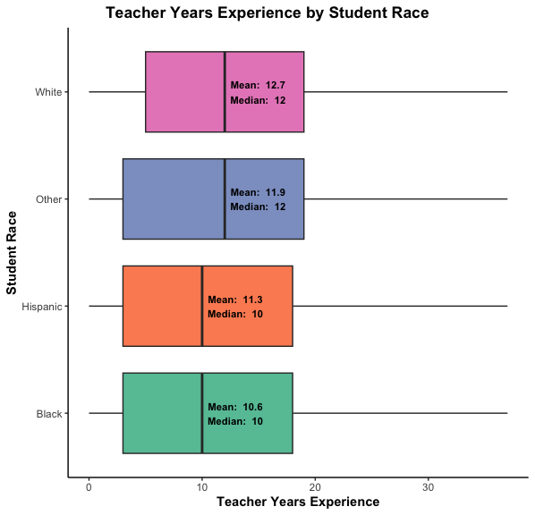
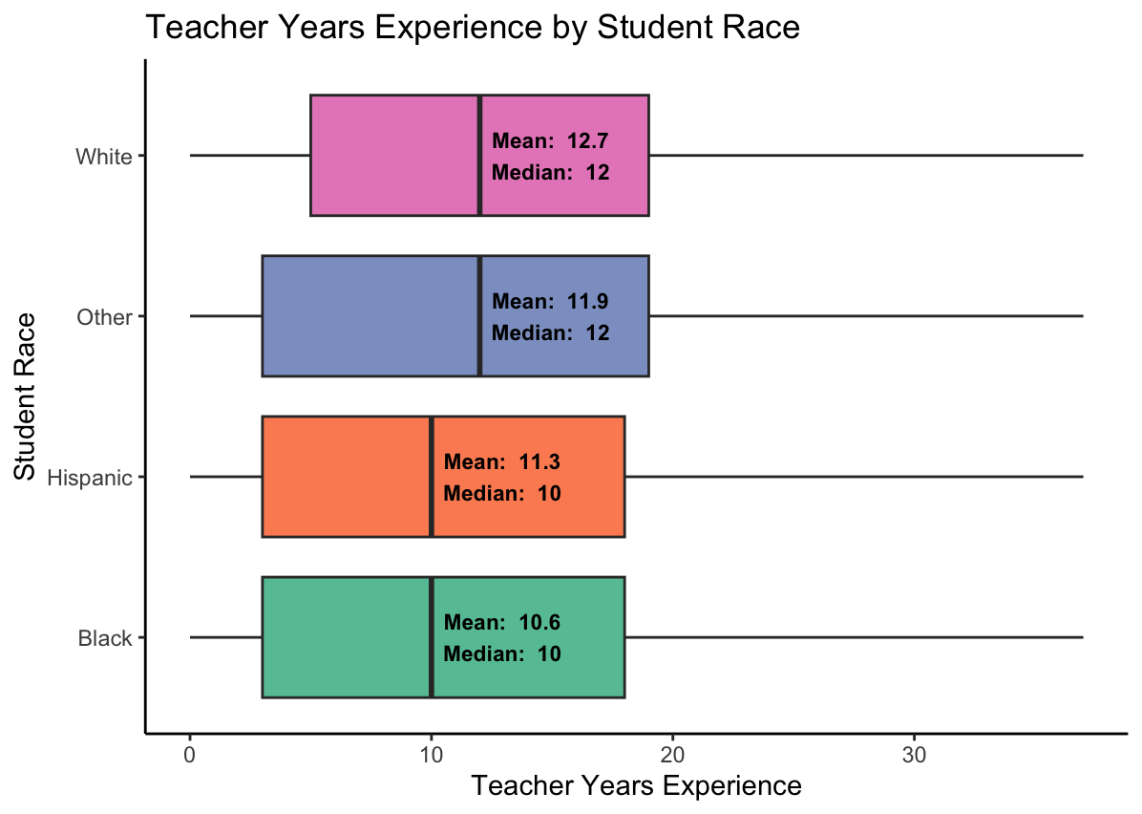
Background EDA
Teacher Certification | Growth | Teacher Experience | Students
None | 6.65 | 11.69 | 6622
Micro | 3.81 | 12.27 | 1564
Full | 12.82 | 14.31 | 1334

Slide 12
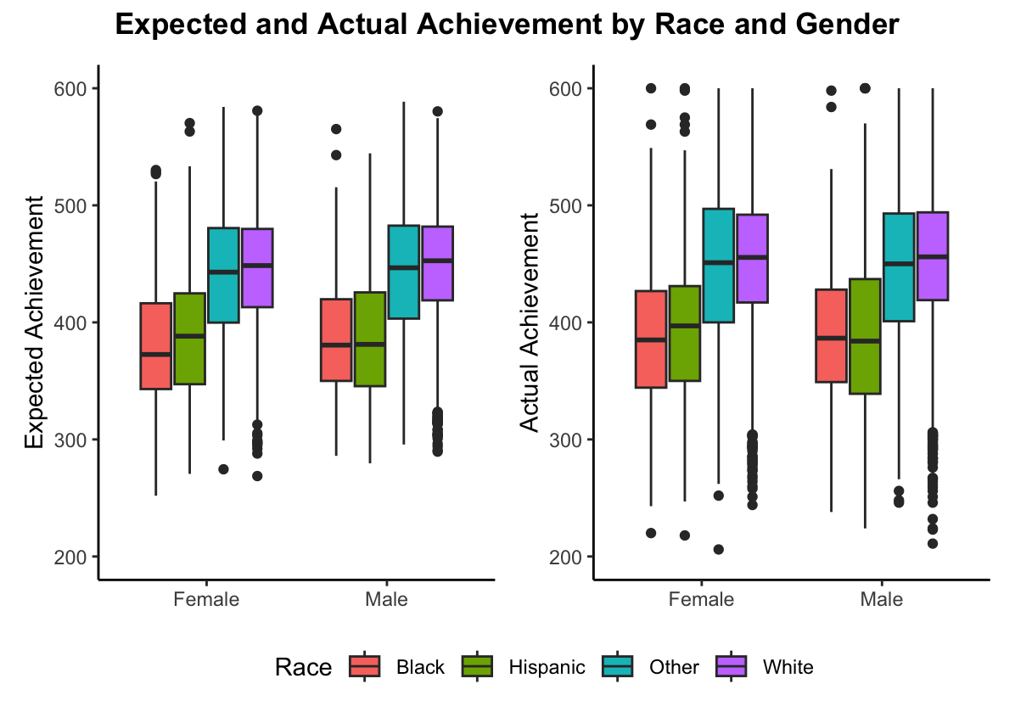
Background EDA

Slide 13
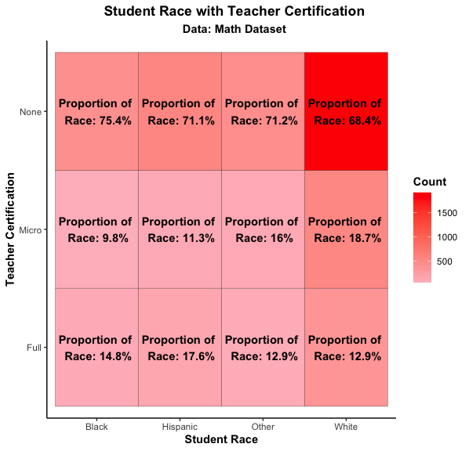

Background EDA

Slide 14
Methodology

Slide 15
Kruskal-Wallis Test
Non-parametric method for testing whether samples originate from the same distribution.
Used to determine whether any of the teach classifications have a significant effect on the outcome.
When significant, Dunn’s test used to determine which certification is significantly different from another.

Slide 16
Regression Models
Univariate linear regression to analyze teacher certification.
Stepwise regression to determine which predictors were strongest.

Slide 17
Regression Models (cont.)
PyCaret package: automates machine learning workflows; end-to-end machine learning and model management tool that exponentially speeds up experiment cycle
Gradient boosting regressor: nonlinear regression model to find relationships between target and feature
Predictor variable groups:
All predictors
Student demographics alone
Teacher and principal certification results.

Slide 18
Results

Slide 19
Growth

Slide 20
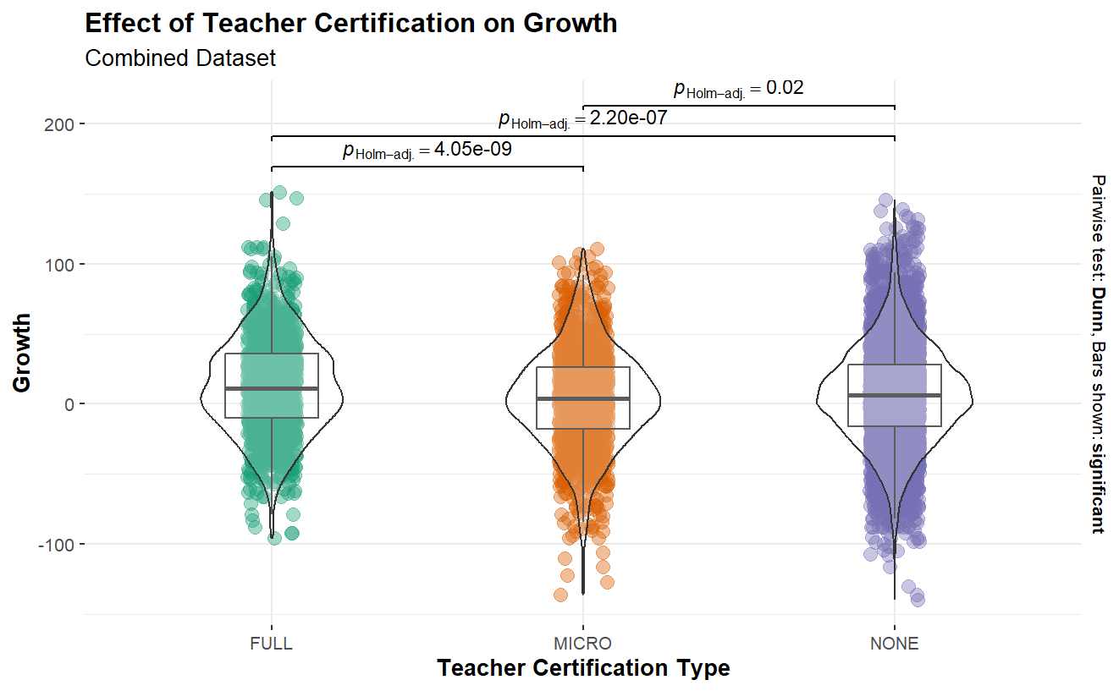
Kruskal-Wallis Test

Slide 21
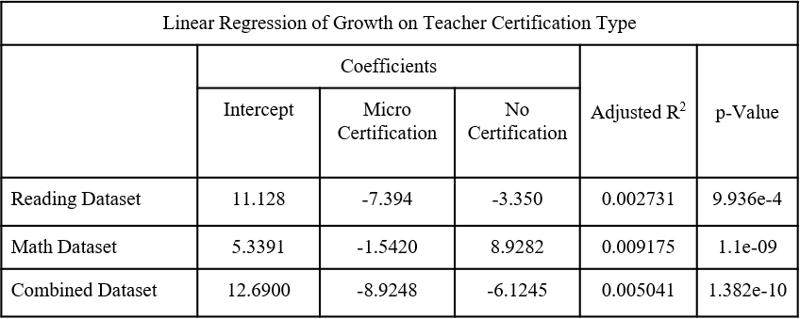
Regression Models
Linear regression
Low R² values
Generally found that no certification is better than a micro certification.
Stepwise Regression
Low R² of 0.03451.
Stepwise Final Predictors:
Teacher certification type, teacher’s race, whether student had disabilities, teacher’s license type, whether student was an English learner, student’s gender, years of experience of teacher.

Slide 22
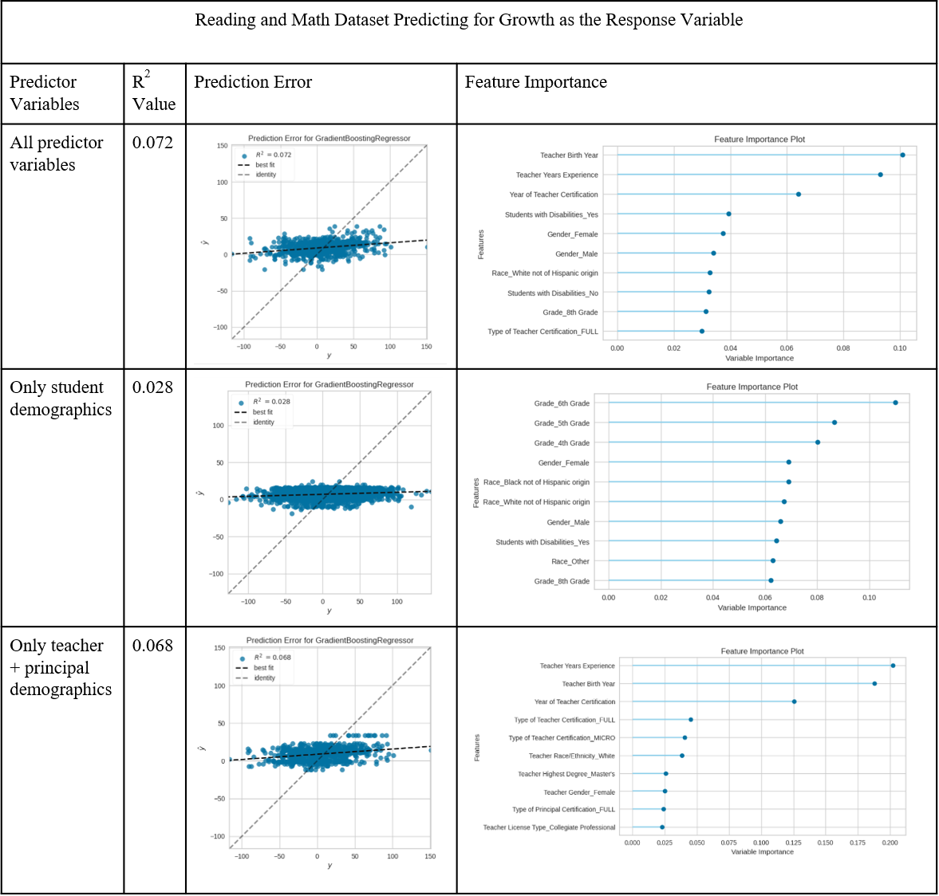
Regression Models (cont.)
Low R² values
Important features for all predictors and teacher + principal demographics: teacher birth year, teacher years experience, year of teacher certification
Important features for student demographics: grade 6

Slide 23
Actual Achievement

Slide 24
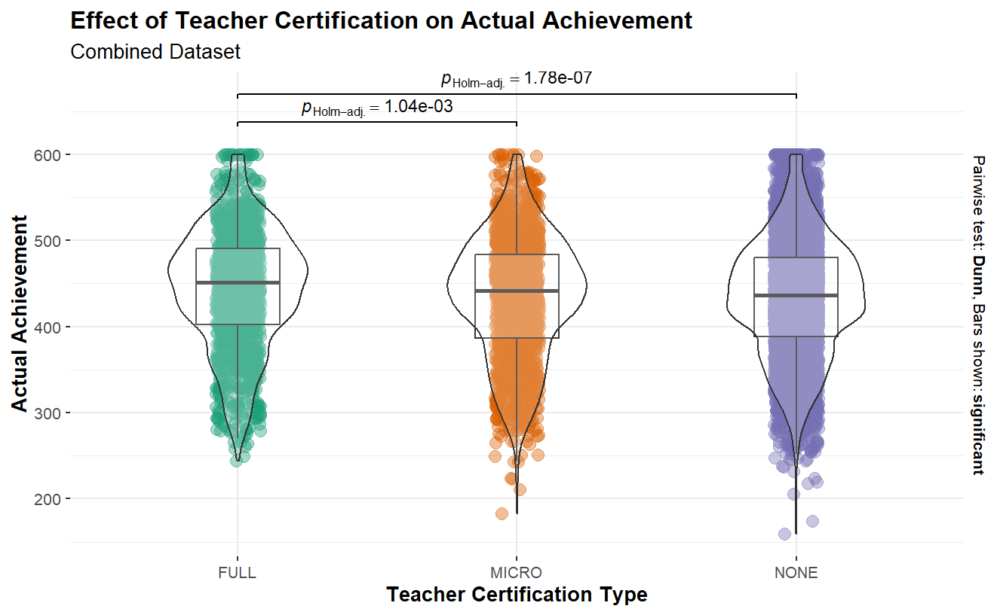
Kruskal-Wallis Test

Slide 25
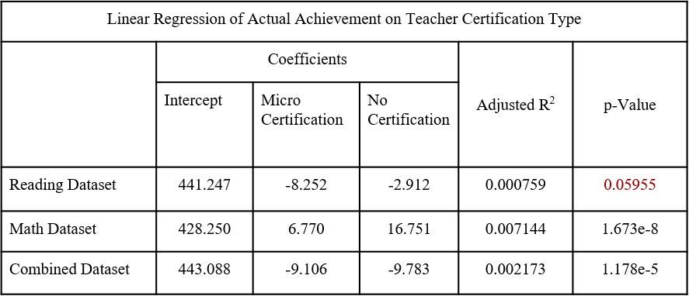
Regression Models
Linear regression
Low R² values
Certification not significant for reading data alone.
Stepwise Regression
Low R² of 0.3417.
Stepwise Final Predictors:
Whether student was an English learner, whether student had a disability, student’s race, teacher’s birth year, teacher’s highest degree, principal certification type, teacher certification type, teacher’s race, type of teacher license

Slide 26
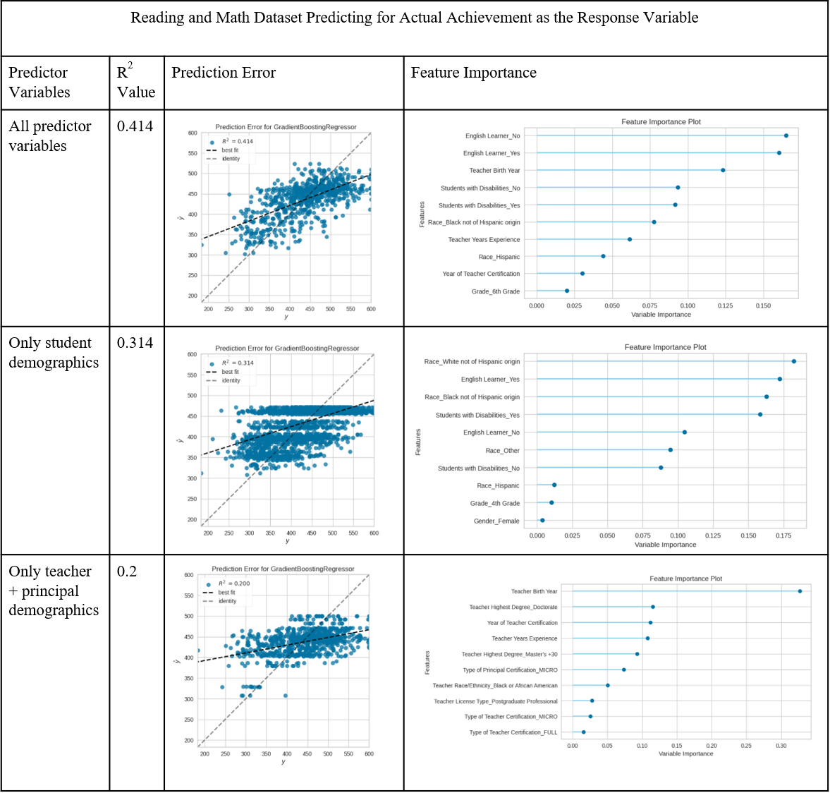
Regression Models (cont.)
Mid R² values
Important features for all predictors and student demographics: not an English learner and a race of white, of not hispanic origin
Important features for teacher + principal: teacher birth year, and teacher’s highest degree

Slide 27
Teacher/Principal Interaction

Slide 28
Teacher/Principal Interaction
Variable | Variance Inflation Factor
Intercept | 1.589840
Type of Teacher Certification | 1.000674
Type of Principal Certification | 1.000674

Slide 29
Conclusion

Slide 30
Summary
Teacher certification does have a statistically significant effect on student achievement.
Generally, more experienced teachers influence growth more strongly.
Student demographics beyond control (e.g., race, English learner, disabilities) showed a strong effect on achievement.

Slide 31
Recommendations
Ensure teacher tenure
Hire teachers with higher degrees/encourage current teachers to pursue additional education
Equitable placing of students with teachers who have been certified

Slide 32
Recommendations (cont.)
For further analysis:
Longitudinal study
Incorporating details of specific schools to generate more precise results

Slide 33
Russell Carlock, Research and Data Analyst, ACPS
Heman Shakeri, Assistant Professor, UVA SDS
Acknowledgements

Slide 34
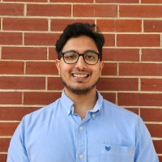


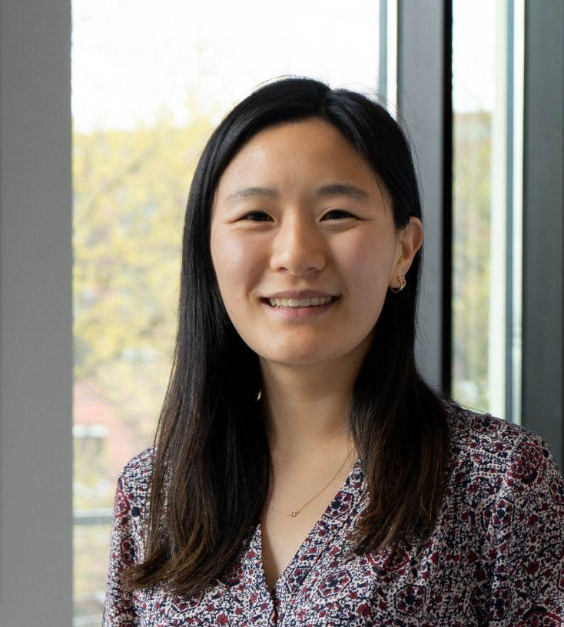
Capstone Team
Sirish Desai | Noah Thro
Stephanie Landas | Michelle Wu
Notes:
And here’s some pretty headshots of our team, thank you for listening to our presentation, and now we'll open the floor for a couple of questions.

